Slide 1
Chapter 8: America Secedes from the Empire
1775-1783

Slide 2
Ch. 7 Review, AGAIN!
Mnemonic device: “S A (Q) D T W I T S”
King George ignores 1st CC “Declaration of Rights” (and grievances).
Fighting begins at Lexington (Paul Revere) and continues to Concord (“shot heard round the world”).

Slide 3
Imperial (British) Strength and Weakness
Strength
Weakness
Population 7.5 vs. 2.5 million
$ $ $ $
Naval power
Ability to hire foreign soldiers (German Hessians)
American Loyalists
Native Americans
Issues in Ireland
The French waiting to get back at the British (F & I War)
American sympathizers in Britain (Whigs)
Needed complete victory
Far from “home”
America is very large
No single capital to capture

Slide 4
Colonist (“American”) Pluses and Minuses
Pluses
Minuses
Leadership (GW, Franklin)
Foreign Aid (M. de Lafayette)
Agriculture
Fighting Defensively
Knowledge of the terrain
Poor Organization/Unity
Jealousy
Economic difficulties
Print paper money to the point of hyper inflation

Slide 5
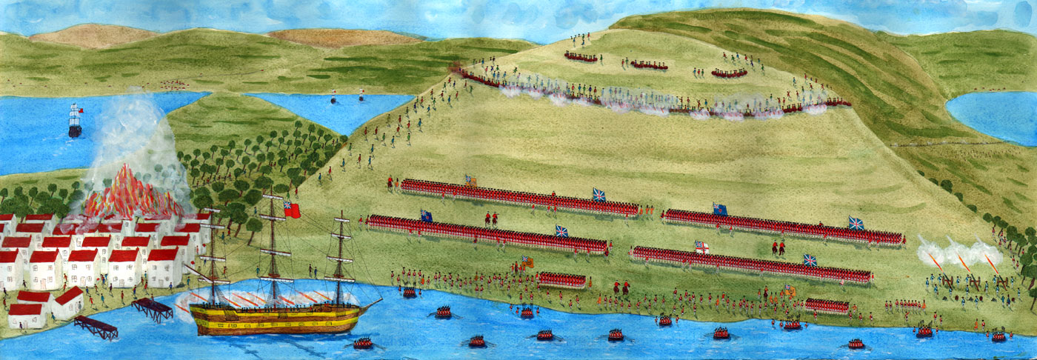
Bunker Hill and Hessian Hirelings
April 1775-July 1776, majority of Colonists were still “loyal” to the crown, but the “Americans” were building an army and navy, and fighting continued.
June 1775: Bunker Hill (British) gives the colonists confidence.
July 1775: the “CC” adopts the Olive Branch Petition professing American loyalty to the crown, King George III declares the colonists in rebellion.

Slide 6
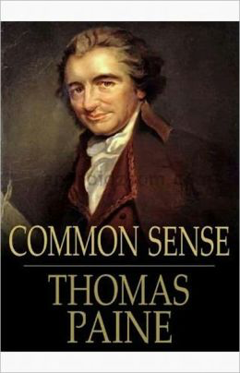
Thomas Paine Preaches Common Sense
January 1776, Thomas Paine (who came from Britain one year earlier) writes Common Sense.
Pamphlet that preached independence. Based upon the need for the consent of the governed.

Slide 7
Paine and the Idea of “Republicanism”
All representatives should derive their power from popular consent.
Colonists had already been practicing this form of government in some areas.

Slide 8
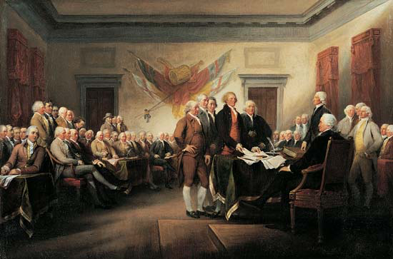
Jefferson’s “Explanation” of Independence
The 2nd Continental Congress approved the Declaration of Independence on July 4th, 1776.
Written by Thomas Jefferson, then 33.
Jefferson borrowed ideas from the enlightenments John Locke, as well as Thomas Paine, and others.
More or less a list of wrongs committed by the King.

Slide 9
Patriots and Loyalists
Revolution was a minority movement.
Patriots (Whigs) fought both the British and the Loyalists.
At the same time, many Americans were indifferent to the war.
What groups were the most loyal?
Older, wealthy, people employed by the British.

Slide 10
The Loyalist Exodus
Following the signing of the DOI, many loyalist fled for Britain, or faced persecution.
Many remained and fought for the British, and some served as spies.

Slide 11
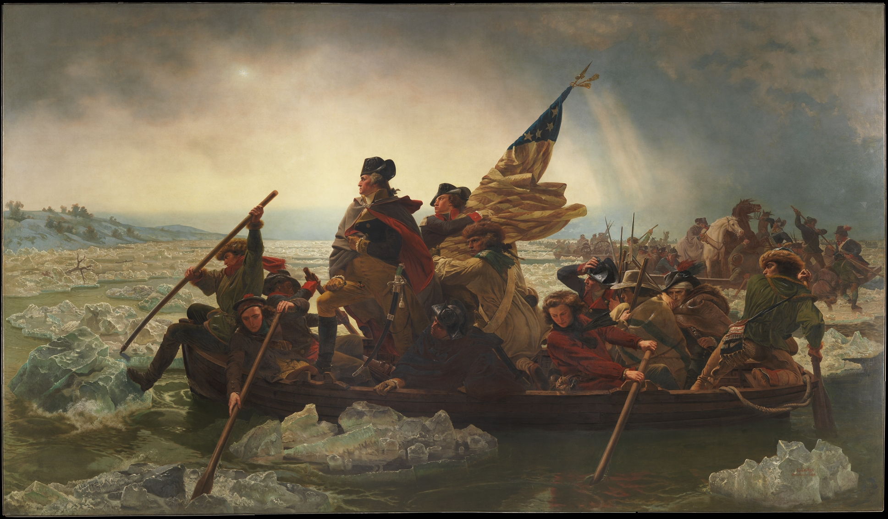
General Washington at Bay
Battle of Long Island: The British decide to take New York as a base of operation, with its large port, and many loyalists.
George Washington did not stand a chance, and retreated to New Jersey
The big issue: why didn’t Howe (British) chase down and crush the small colonial army?

Slide 12
Burgoyne’s Blundering & Revolution or Diplomacy?
Burgoyne was sent to control the Hudson River & NE.
He’s defeated in two separate battles at Saratoga.
Considered by many as the turning point in the war, causes the French to join the fight.
Model Treaty: only a commercial connection suggested by John Adams.
1) No political connection
2) No military connection
3) Only a commercial connection!

Slide 13
The Colonial War Becomes a Wider War
The Spanish and Dutch join the French to fight the British on the seas.
What’s in it for them?
The British are forced to consolidate their troops in New York.

Slide 14
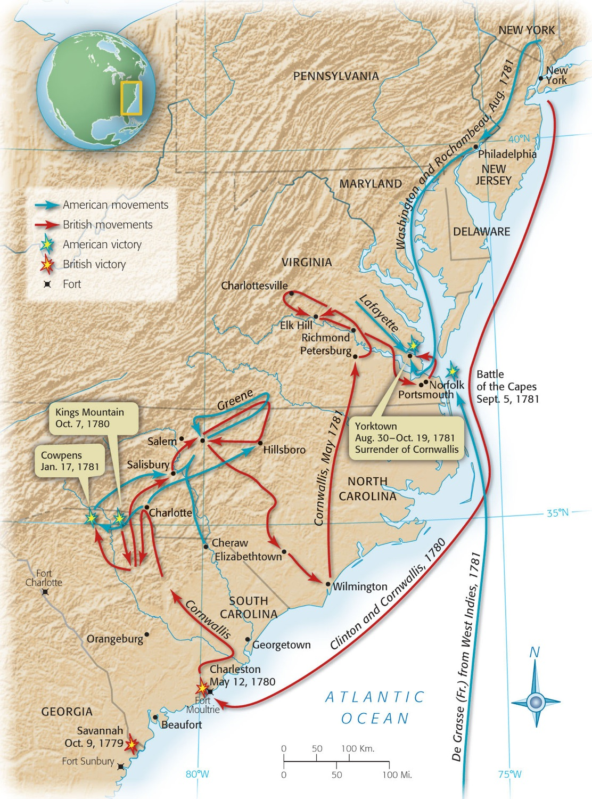
Blow and Counterblow
Benedict Arnold pulls a uh...“Benedict Arnold.”
Tries to sell out West Point (on the Hudson River) to British. The agreement was uncovered and Arnold fled to the British.
The British attempt to roll up the colonies from the south.

Slide 15
The Land Frontier and the Sea Frontier
Native Americans fight on both sides, causing many problems in the frontier areas.
Americans = not an effective navy but they hire privateers
Private ships hired to harass the British Navy, basically legalized piracy.

Slide 16
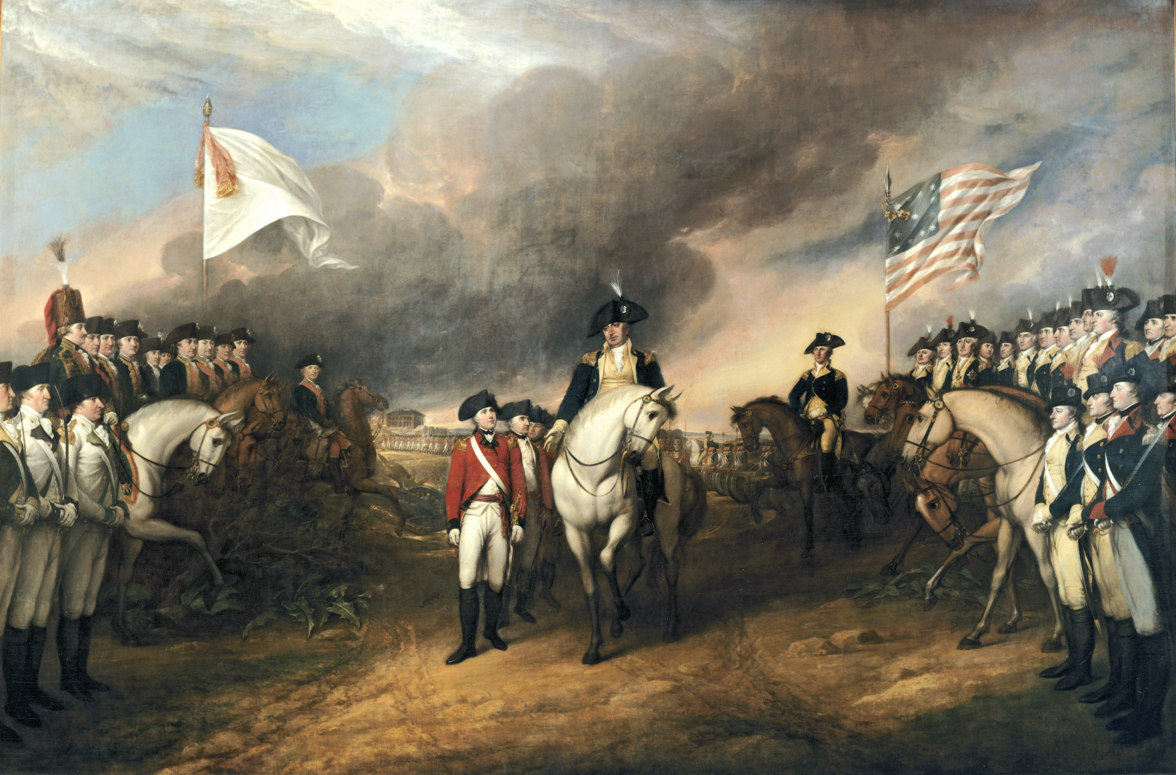
Yorktown and the Final Curtain
1780-1781: Difficult time for the United States…currency was vary inflated, offered to pay debts at 2.5 cents on the dollar
Cornwallis: struggling in the south sets up at Yorktown to be resupplied.
Washington marches on Yorktown, while the French blockade the British ships. Cornwallis is forced to surrender in October 1781.

Slide 17
Peace at Paris
Treaty of Paris 1783, officially ends the Revolutionary War (Franklin, J. Adams, J. Jay).
The United States was granted land as far west as the Mississippi and as far north as the Great Lakes.
Loyalist lands were returned, and the United States agrees to not interfere with Britain collecting debts from Americans.

Slide 18
A New Nation Legitimized
Why such generous terms?
To keep the Americans on the side from getting too close with the French (Napoleon).
The French didn’t object to the treaty as they were happy to have to stop spending money on the conflict.

